Slide 1
IACBE Region One Conference
October 18, 2018
Speed Presentations
Round One

Slide 2

Inspiring Leaders
A Journey of self-discovery
Kim Kenney-Rockwal, MBA, SPHR, SCP

Slide 3

82%
Source: HBR

Slide 4

Closing the competency gap

Slide 5
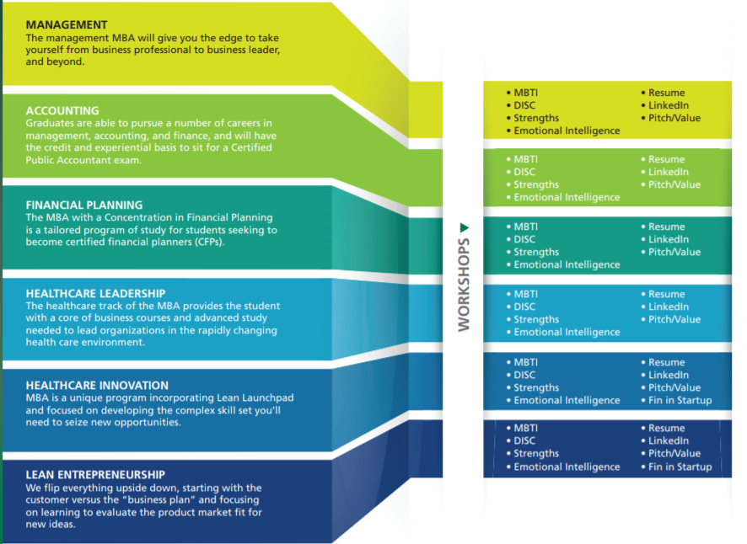
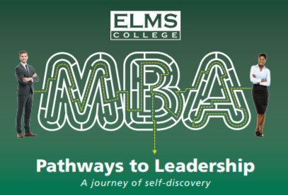

Slide 6
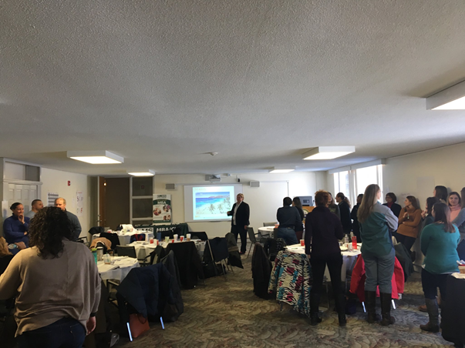
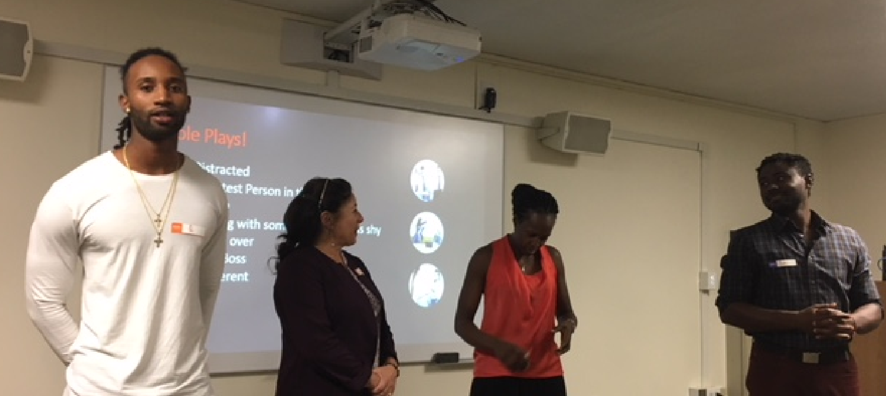

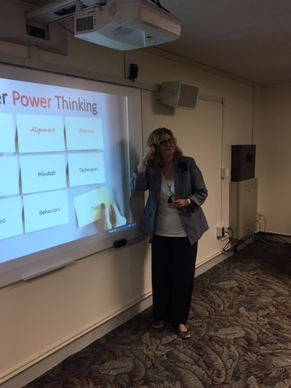
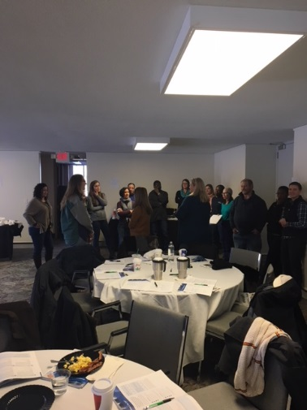
Self-aware employees =
Higher stock performance
Source: Korn Ferry

Slide 7


Making Principles of Marketing Real
Michael Mozill
Associate
Professor of Management
Through Civic Engagement Based Consulting Projects

Slide 8


How do we do this?
Step 1 – Faculty identifies clients.
Step 2 – Students from groups.
Step 3 – Students work with their client to identify a marketing problem.
Step 4 – Students develop solutions.
Step 5 – Students present their solution to the client.
Through a Five Step Process

Slide 9




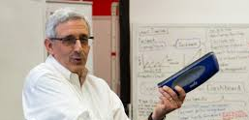

Who benefits?
The Institute’s Stakeholders

Slide 10








Who benefited?
Some of the Client Companies

Slide 11
AIN’T NOTHING LIKE THE REAL THING*
* With apologies to Marvin Gaye and Tammi Terrell

Slide 12
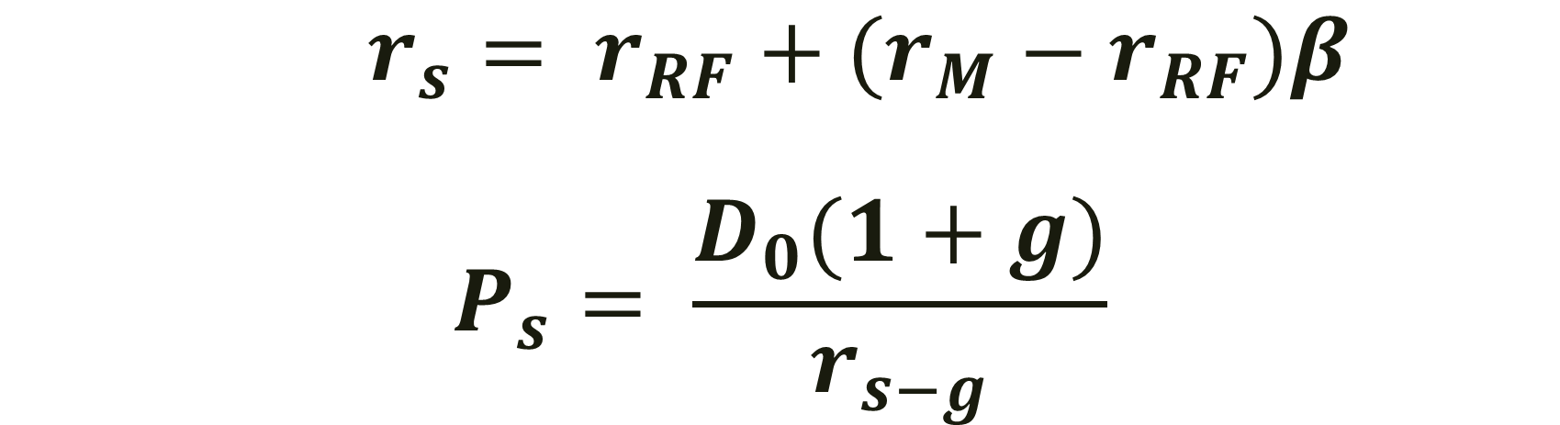
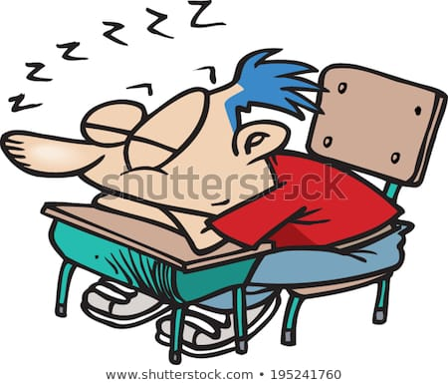

Slide 13
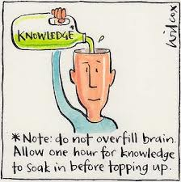

Slide 14
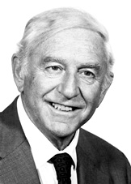
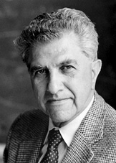
Heroes of Finance
Merton Miller Franco Modigliani
Theorems relating to a Firm’s indifference to capital structure

Slide 15
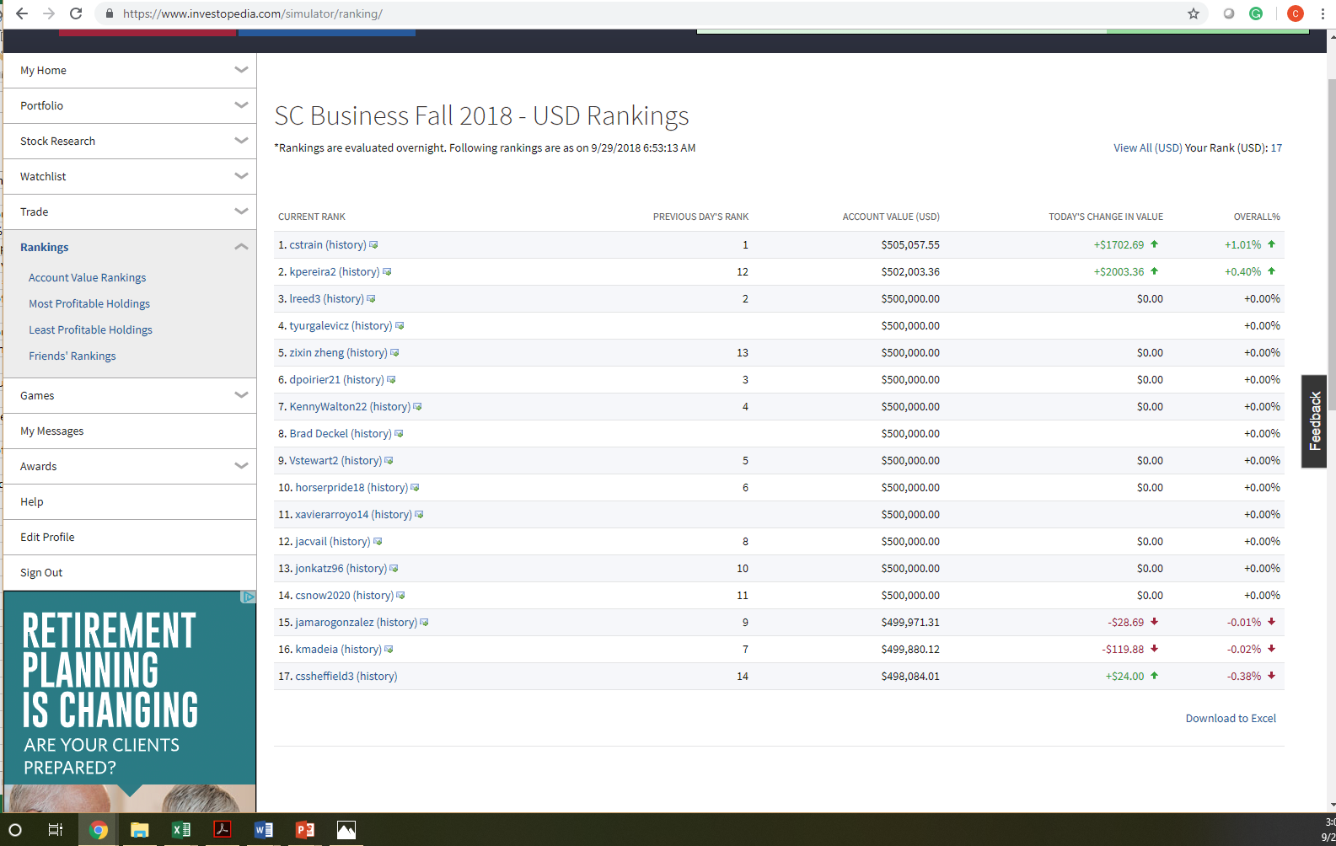
Simulation for class competition

Slide 16
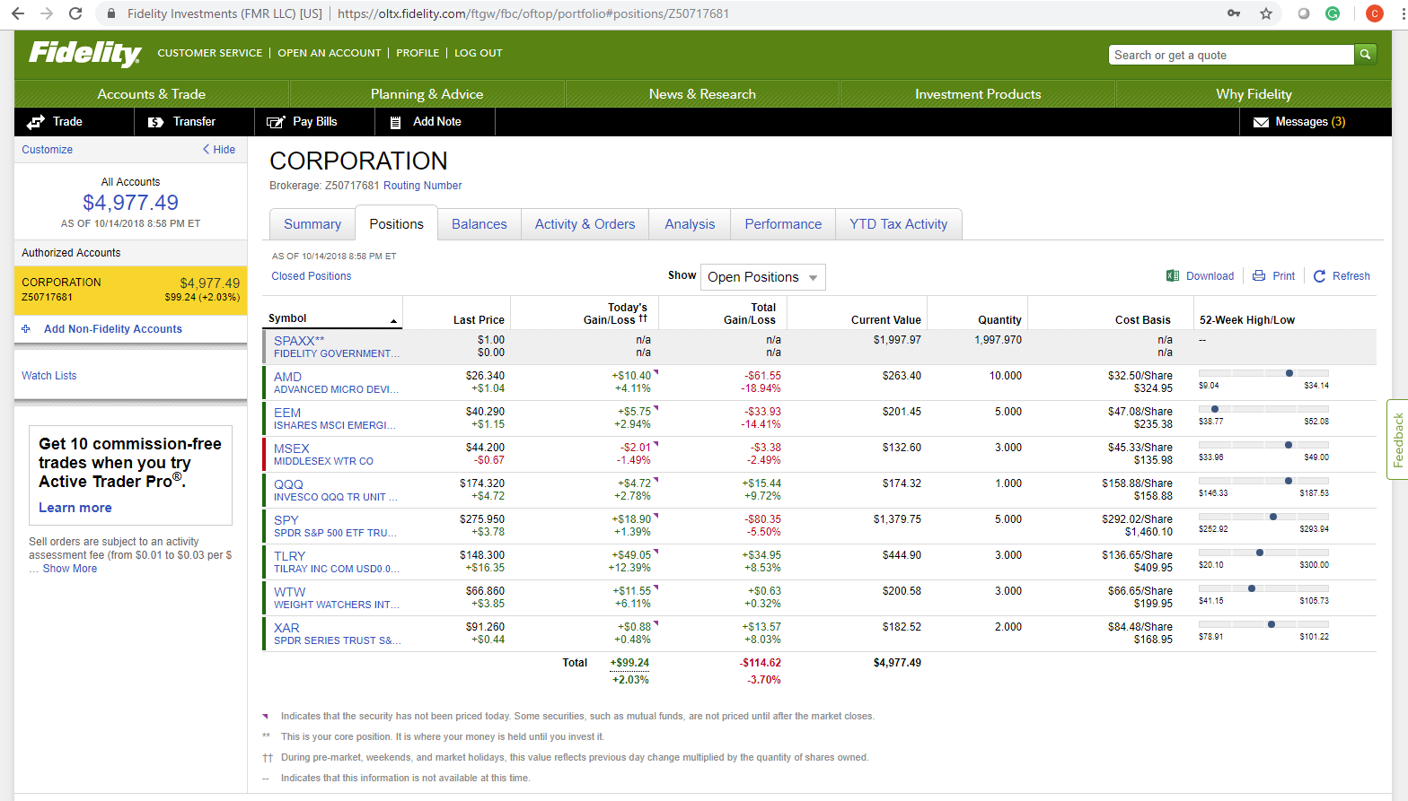

Slide 17
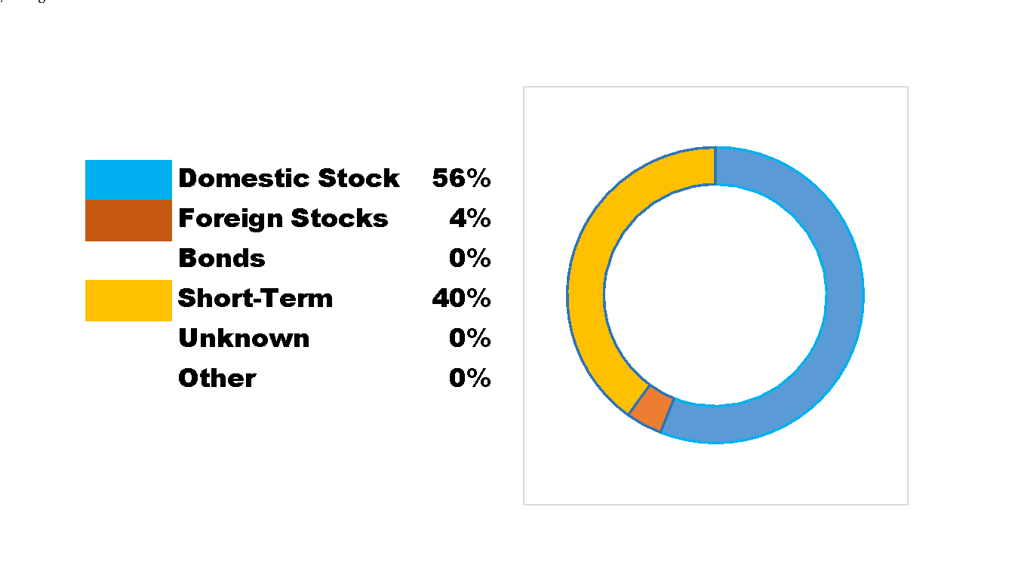
Student Learning Outcomes
Efficient Market Hypothesis
Risk/ Return
Allocation
Transaction Costs
Diversification
Behavioral Economics
Real Money – Real Lessons

Slide 18
Pursuing Accreditation: Gaining Commitment to and Ownership of the Self-Study
Jeff Mello
RHODE ISLAND COLLEGE

Slide 19
Building a Team
Importance of buy-in / shared responsibility and ownership
Administrative team meeting (Chairs and Directors) to determine responsibilities
Accreditation Self-study team (Program Coordinators - compensated) with regular meetings

Slide 20
Principles 1-3
Principle 1 – Integrity/Responsibility/Ethics; Dean (draft)
Principle 2 – Assessment; Dean 2.1 and 2.2; PAC 2.3; together 2.4
Principle 3 – Strategic Planning; Dean

Slide 21
Principles 4-6
Principle 4- Curricula; Dean 4.1 (1-5), 4.7; PAC 4.1 (6-9), 4.2- 4.6; together 4.8
Principle 5 – Faculty; Dean 5.2, 5.4-5.7; PAC 5.1; together 5.3
Principle 6 – Students; Dean

Slide 22
Principles 7-9
Principle 7 – Resources; Dean
Principle 8 – External Relations; PAC
Principle 9 – Innovation; PAC

Slide 23


Slide 24

FULBRIGHT S-I-R PROGRAM:
AN OPPORTUNITY FOR INTERNATIONALIZATION OF
A BUSINESS CURRICULUM
Tamila Nutsubidze, PhD
Fulbright Scholar in Residence at
Fisher College
2018

Slide 25
Fulbright Scholar-in-Residence Program
The Fulbright Scholar-in-Residence (S-I-R) Program assists U.S. higher education institutions in expanding programs of academic exchange, by supporting non-U.S. scholars through grants for teaching at institutions that might not have a strong international component and/or serve minority audiences.
https://www.cies.org/program/fulbright-scholar-residence-program
Opportunities provided by S-I-R:
  Internationalization of programs;
  Development of curricula and faculty;
  Diversification of students’ and faculty experiences.

Slide 26
S-I-R Overview
S-I-R gives preference to the following:
Asian-American and Native American/Pacific Islander-Serving
Institutions (AANAPISI)
American Indian and Alaskan Native-Serving Institutions (AIANSI)
Historically Black Colleges and Universities (HBCU)
Hispanic-Serving Institutions (HSI)
Predominantly Black Institutions (PBI)
Tribal Colleges and Universities (TCU)
Community Colleges
Small Liberal Arts Institutions
Rural colleges and universities

Slide 27
SApplication & Timeline
Application Guidelines & Resources
Available at: https://www.cies.org/document/s-i-r-application-guidelines-institutions
Beginning March 2018 – October 15, 2018

Slide 28
Highlights & FAQ
S-I-R Awarded Institutions & Fulbright Scholar-in-Residence Institutions by location since 2007
Available at: https://www.cies.org/program/fulbright-scholar-residence-program
FAQ
Available at: https://www.cies.org/program/fulbright-scholar-residence-program

Slide 29
Speed Presentations
Round Two

Slide 30
Integrating Global Context into Business Courses
Kathy Zilch CPA, PhD
Associate Professor - Online

Slide 31
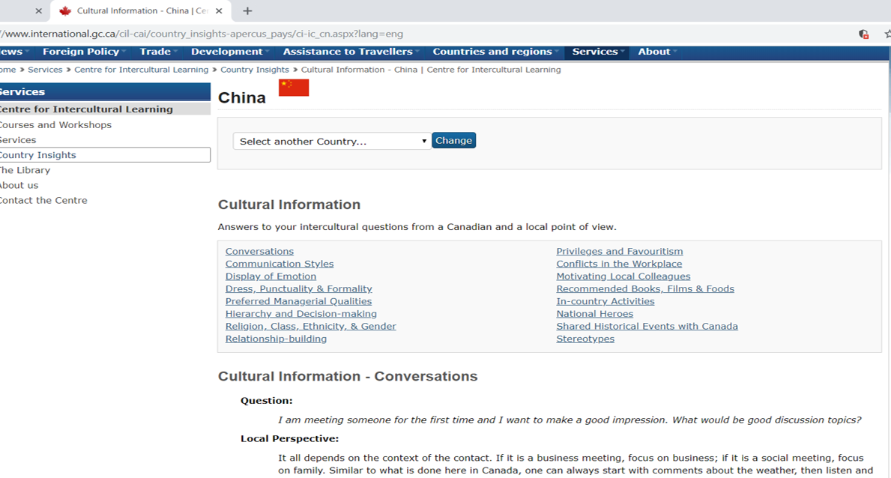
Country Insights
Courses:
  Principles of Business
  Business Communication
  Management
  Leadership
  Global Business

Slide 32
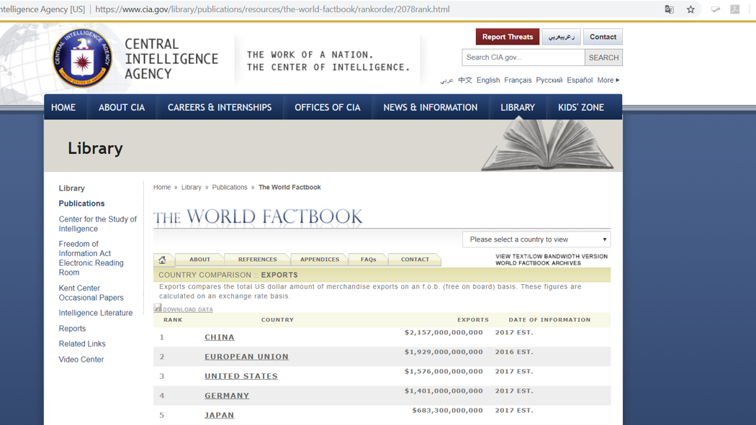
CIA World Factbook (1 of 2)
Courses:
  Economics
  Finance
  Quantitative Analysis
  Corporate Social Responsibility
  Global Business

Slide 33
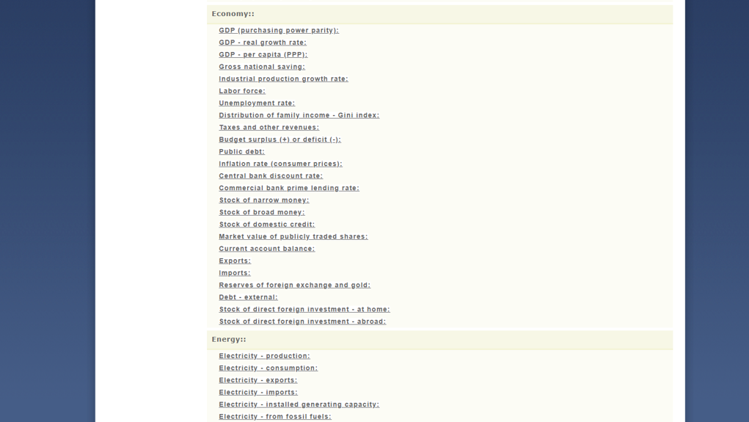
CIA World Factbook (2 of 2)
80 Data Sets,
in 7 Categories:
Geography
People and Society
Economy
Energy
Communications
Transportation
Military (% of GDP)

Slide 34
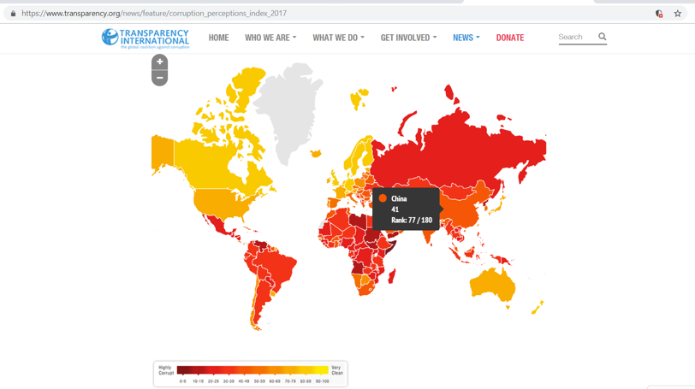
Corruption Perceptions Index (1 of 2)
Map View
Courses:
  Business Ethics
  Leadership
  Management
  Finance
  Global Business

Slide 35
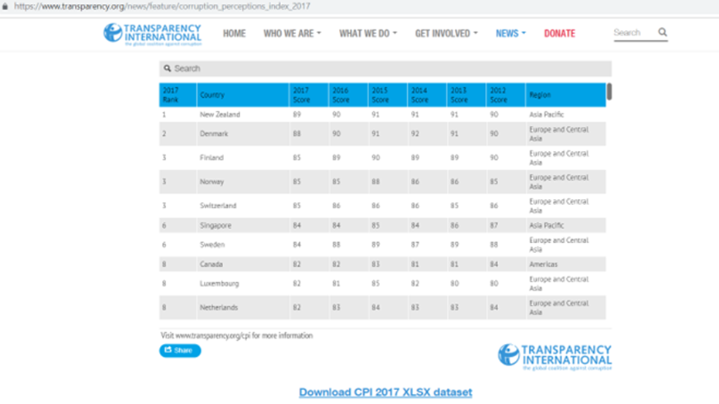
Corruption Perceptions Index (2 of 2)
Table View
  Search
  Download to Excel
U.S. #16

Slide 36
Resources
Corruption Perceptions Index 2017. (2018, October). Retrieved from Transparency International: https://www.transparency.org/news/feature/corruption_perceptions_index_2017
Country Insights. (2018, October). Retrieved from Global Affairs Canada: https://www.international.gc.ca/cil-cai/country_insights-apercus_pays/ci-ic_cn.aspx?lang=eng
Guide to Country Comparisons. (2018, October). Retrieved from CIA World Factbook: https://www.cia.gov/library/publications/the-world-factbook/rankorder/rankorderguide.html

Slide 37

Understanding the Role of Culture in International Students In-Class Behavior
Santiago Umaschi
Assistant Professor
umaschis@wit.edu

Slide 38

Nature of Culture
Learned, not innate
Invisible to those accustomed to particular culture

Slide 39
Hofstede’s Cultural Dimensions
Power Distance
  High Power Distance
  Low Power Distance
Community Ties
  Individualism
  Collectivism
Societal Gender
  Masculinity
  Femininity
Uncertainty Avoidance
  High Uncertainty Avoidance
  Low Uncertainty Avoidance
Temporal Orientation
  Short Term
  Long Term
Gratification
  High Indulgence
  High Restraint
Hofstede, G. Asia Pacific J Manage (1984) 1: 81.

Slide 40

Most Relevant Cultural Differences
Power Distance
Time
  Monochronic
  Polychronic
Tolerance for conflict
Gender roles

Slide 41

Dimensions of Cultural Diversity
High-Context
  Meaning conveyed subtly
    Save face
    Social harmony
Low-Context
  Meaning conveyed by words spoken

Slide 42
So…..What do we do?
We are a US University, in the US…. Our culture rules ☺
Research….
Communicate, Understand, BUT
Explain how the behavior is perceived in the US and what the expectation is

Slide 43
Thank you!!

Slide 44
Applying Design Thinking to Accounting Course Structure
SARA SMIAROWSKI
ASSISTANT PROFESSOR OF ACCOUNTING, ELMS COLLEGE

Slide 45
What? Why?
WHAT?
  Trending topic in business education
  Focus on users’ experiences, especially emotional ones
    Traditional proposition of the classroom: You will learn the subject
    Emotional value proposition: You will enjoy the classroom experience while learning the material ; increase student satisfaction
      Increased student satisfaction leads to higher retention in an increasingly competitive admissions environment
WHY?
  Accounting courses have not been updated
    Stale topic; accountants are often less likely to adopt teaching to new industry needs
    Often difficult subject for non accounting majors

Slide 46
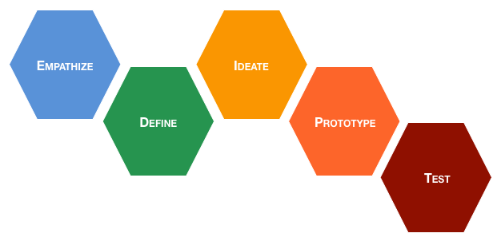
EMPATHIZE:
INTERVIEW AND LEARN FROM STUDENTS.
  M/F, Caucasian or person of color
  Digital native
  Difficulty paying attention
  Hard subject
  See accounting as irrelevant/”have
to take this class”
  Less lecture, more activities
DEFINE:
DEVELOP THE POV BASED ON NEEDS OF STUDENTS
  How might I make accounting relevant?
    Doing so will further engage students
    Helps accounting students become integrated thinkers
    Encourage “deep learning”, moving into the higher levels of Bloom’s taxonomy of applying and analyzing

Slide 47
IDEATE:
BRAINSTORM AS MANY CREATIVE SOLUTIONS AS POSSIBLE
  Read articles in Issues in Accounting Education, etc. for ideas
  Case study format
  Relevant business examples:
    Andre’s Shoe Shop
  Project based team learning
  Make my own material – no book
  Move classrooms out of labs
  Don’t teach debits or credits
  More technology
PROTOTYPE:
BUILD A VISUAL REPRESENTATION OF IDEAS
  Sketched outline of classes and projects
  Sketch was moved into Moodle to build outline

Slide 48
TEST:
CHECK IN WITH STUDENTS DURING SEMESTER FOR FEEDBACK ABOUT PROTOTYPED IDEAS
  Requires being flexible from class to class
  POSITIVE:
    No computers in classroom – considered distracting
    Diagnostic quizzes on their phones using QR codes, good way to break up routine and assess retention
  NEGATIVE:
    Snapchat – first years thought it was weird, upper level classes thought it would be interesting
  Still in Process! Know more after semester!

Slide 49
Community Partnerships: Promoting Green Business and Sustainability in Business Schools and Programs
Jeff Mello
RHODE ISLAND COLLEGE

Slide 50
Rhode Island Green Business Forum
Launched by College’s Sustainability Coordinator in 2013
School of Business co-sponsorship starting in 2016
Rhode Island Renew Energy Initiative partnership in 2018

Slide 51
Goals
Engage business school with practitioner and policymaking communities
Networking opportunities for students
Deliver mission of college and business school

Slide 52
Programs
Sustainable / green investing
Financing of green business and sustainability initiatives
Entrepreneur’s panel on Cleantech Ventures / transforming green business into green profits
Sustainability in health care

Slide 53

The Future of Learning is the Experiential Model
Lee P. Speronis, J.D., C.H.E.,C.H.I.A..
Director/Associate Professor
School of Hospitality, Sport & Tourism Management
College of Business
Husson University

Slide 54


Accelerated Learning
Experiential Learning includes:
1-Critical Thinking
2-Problem Solving
3-Decision Making
Learning by doing while/after Learning by theory

Slide 55
Bridges the Gap
We need theory: textbooks & classroom
Theory must become practical through
Simulations & Internships which bridge the gap
Immediate application of knowledge
Real-time coaching, feedback & reflection

Slide 56
Increases Engagement
Student and mentor are directly involved
Collaboration in problem solving activities
Ownership of the outcome is created
Engagement is like swimming:
“You have to get in the water, you can not learn how to swim by reading about it.”
-Henry Mintzburg

Slide 57
Return on Investment
Retention is an issue, we need students to stay
Experiential Learning is more personal
Customizing the Internship Experience
Create an emotional bond to learning, beyond classroom
Retention drives R-O-I, by reducing turnover

Slide 58
Personalized Learning
Establish a safe learning environment
Student set their own learning pace
Tools such as zoom link campus with work site
Internship and site mentors both coach
Flipping the classroom

Slide 59
Measuring
Results
Combine with simulations: AHLA certification exams
Have portfolio requirements, specific projects
Develop reflective learning habits
Establish some data driven tools, consistent rubrics
Assessment is essential

Slide 60
The Experiential Learning Cycle
Experience>
Reflect>
Conceptualize>
Experiment>
Professor D.A. Kolb-Case Western Reserve

